Slide 1
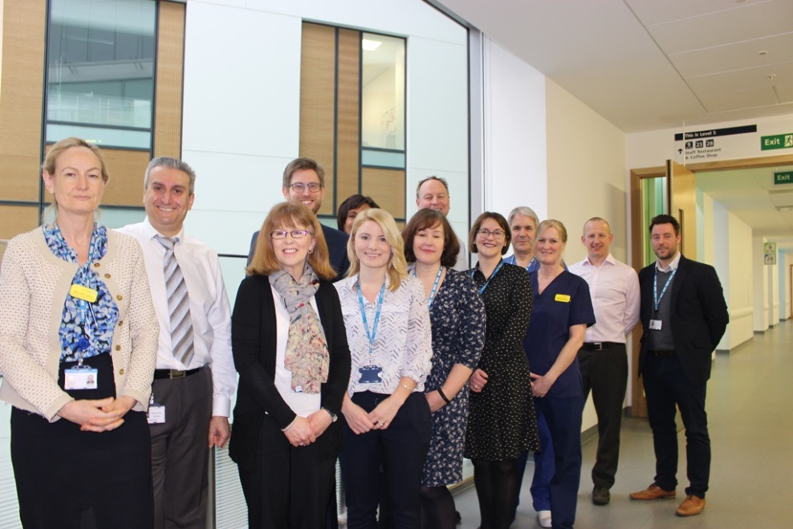

An Electronic 2 Week Wait Referral System for Colorectal Cancer
North Bristol NHS Trust
South Gloucestershire CCG

Slide 2
Why Use the ICE 2WW Referral System?
Allows GPs to book straight to test
Takes away the need for a structured referral form and internal triage to test
Has reduced the time to colorectal cancer diagnosis from 28 to 11 days
Improved 62 day cancer performance
Good feedback from GPs and patients

Slide 3
Patient Feedback
All patients said they would prefer to be contacted as quickly as possible and would like tests as soon as possible
All patients gave positive feedback
The important part for patients was to find out what was wrong quickly, and to get peace of mind and treatment as soon as possible
80% of patients felt the GPs were good and explained the pathway
All patients described that being informed by the GP in detail, and receiving an appointment quickly were the 2 most important things for them

Slide 4
Improved Performance Against 62 day Target
Cancer performance increased from 69% to 82%
n
Months

Slide 5
New System
Referral pathway based on symptoms
Guidance advises GPs what test to order
GP books test via e booking system or clinic via C&B
We track the patient internally to meet cancer targets
Test shows cancer/significant abnormality
Test is normal or non cancer diagnosis
We deal with ongoing tests
Back to GP with advice
Notes:
Considered different models but we went option 2

Slide 6
Important Points to Consider
Inform patients of risks of tests
Ensure they are fit for test
Be aware of the caveats for each test eg patients having CTC need a PR
Do not book more than one test at a time
Do not book a test if the patient has had one within the year

Slide 7
Colonoscopy
Requires full bowel prep with risks of dehydration/AKI
Risk of perforation
Risk of bleeding
Risk of incomplete examination
Requires patient to have painkillers and sedation
Patient needs to be mobile

Slide 8
Flexible Sigmoidoscopy
Requires no sedation. Patient can have entonox
Preparation is a phosphate enema
Extremely small risk of perforation
Small risk of bleeding
Patient needs to be mobile

Slide 9
CT Colonoscopy (Virtual Colonoscopy)
The patient must have a PR examination -CTC is not good at assessing anorectal junction
Radiation exposure
Patient must be able to
  Lie prone
  Tolerate oral gastrograffin (not full bowel prep)
  Tolerate rectal insufflation

Slide 10
Who to send to clinic instead of straight to test?
It is an option for anyone
The pathway of choice for patients with an abdominal or rectal mass
Frail complex elderly if concerned they are not fit for any test including a plain CT scan
Patients who are unable to give consent for a test

Slide 11
Please Make Sure your Patient is Free to Attend within 2 weeks
In the first year
  10% declined colonoscopy, 1.5% DNA
  6% declined flexible sigmoidoscopy, 1% DNA
Please check patient is willing to have the test and understands
Download patient information and give to patient

Slide 12
New NICE Guidance
There are many combinations of symptoms to consider now but in order to use ICE it is important that you start with the main symptom

Slide 13
Start with the main symptom as described in the guidance
>50 with unexplained rectal bleeding-Book flexible sigmoidoscopy on the right side of the screen
Abdominal or rectal mass-this test is a symptom that still requires clinic referral via NHS eReferrals found on the right of the screen
For all other symptom complexes the recommended test is colonoscopy, CT colonoscopy or plain CT depending on fitness

Slide 14
2WW Symptoms-recommended test
All symptom complexes in new NICE guidance requiring colonic imaging (all symptom complexes apart from rectal bleeding alone or a mass)
Algorithms for age and symptoms built into the requesting system
AGE TEST
60-75 colonoscopy
75-85 CTC
>85 CT with extended oral prep
and
Iron Deficiency anaemia
OGD
Unexplained rectal bleeding age >50
Flexible sigmoidoscopy with PO4 enema
Abdominal or rectal mass
Clinic via NHS eReferral

Slide 15
Recommended Age for Tests
Colonoscopy up to age 75
  It is not possible to book a colonoscopy on the ICE system for a patient over 80
CT colonoscopy between 75-85 or unfit for colonoscopy
Plain CT over 85 or unfit for any other test

Slide 16
Finally
Download patient information leaflets using the links
Any problems contact
Anne.pullyblank@nbt,nhs.uk
Ann.lyons@nbt.nhs.uk
Cancer office

Slide 17




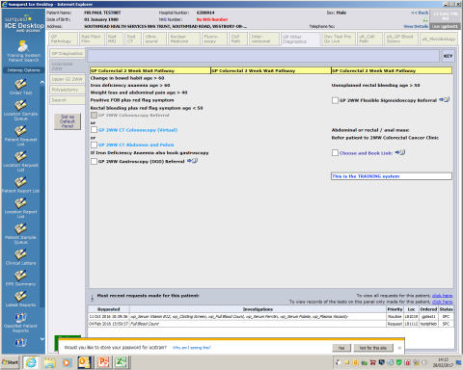



1125 outpatient
appointments
5250 referrals
80% straight to test
1751 CTC
1980 colonoscopy
Reduced mean time to diagnosis
From 28 days to 11 days
Improved 62 day cancer performance
Positive Feedback from patients and GPs

