Slide 1


EQUALITY, DIVERSITY & INCLUSION (EDI) Workforce Disability Equality Standard
(WDES) Plan
October 2023

Slide 2

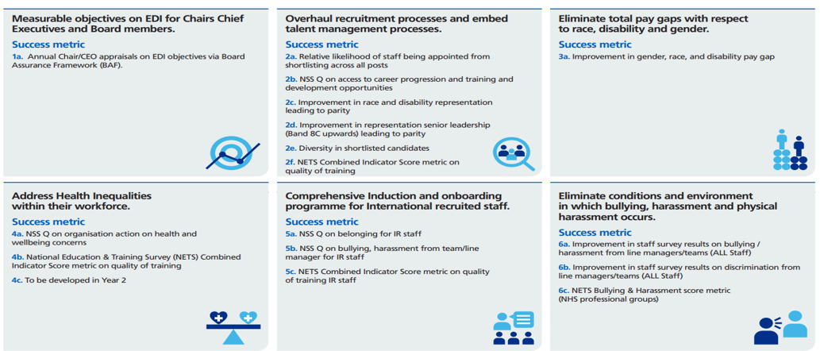
NHSE EDI Improvement Plan (June 2023)
6 High Impact
Actions
The NHS England plan prioritises the following 6 high impact actions to address the widely known intersectional impacts of discrimination and bias. These actions have been embedded into our plan for NBT.

Slide 3










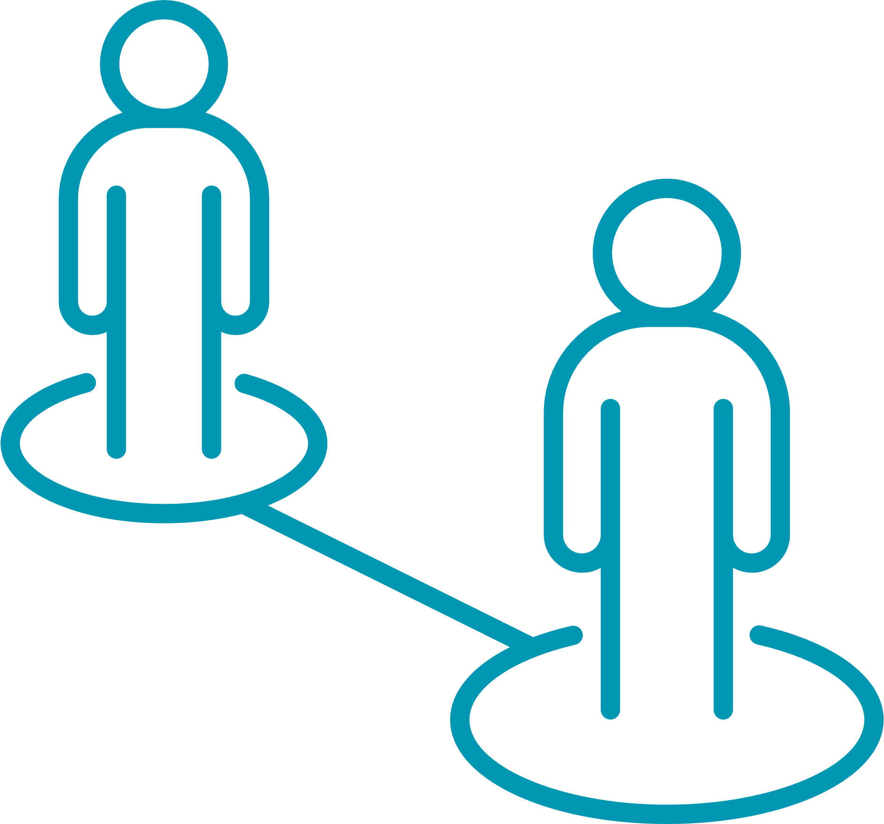

EDI WDES PRIORITIES
  2 Eliminating discrimination, harassment, bullying & violence
  1 Ensuring EDI ownership & accountability
  3 Embedding diverse & fair recruitment
  4 Closing the pay gap
Commitment to our Community
Proud to belong

Slide 4
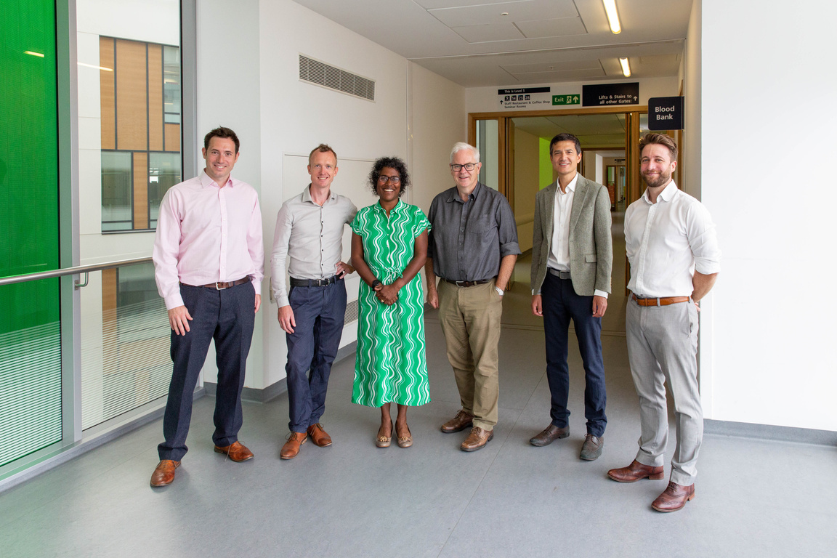
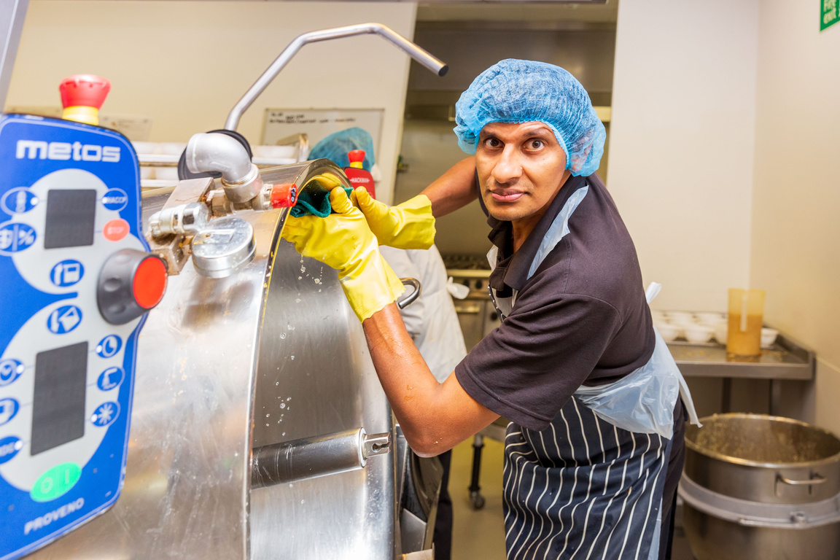
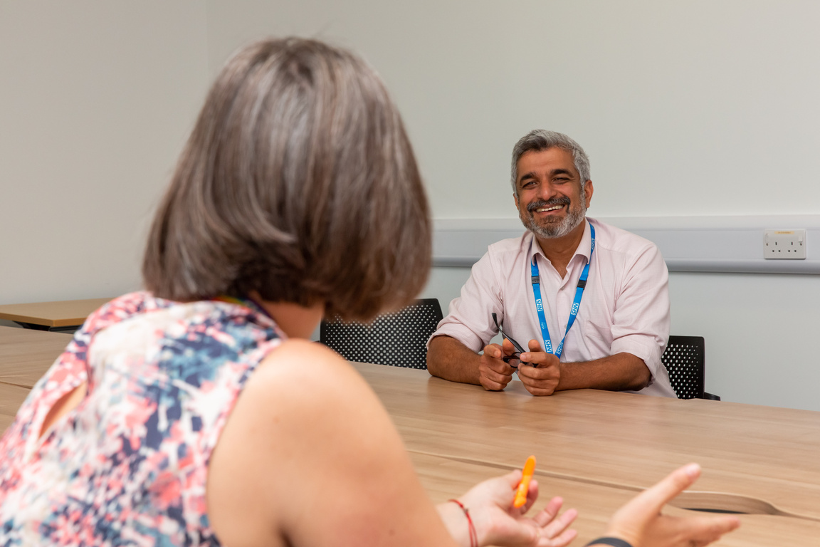
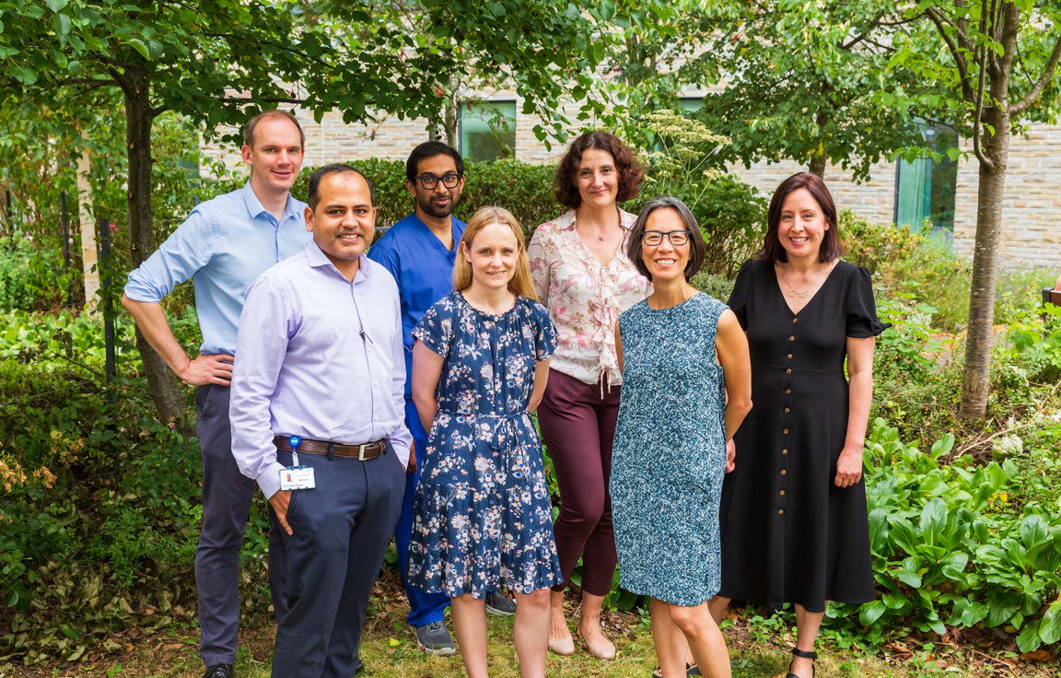




Why these priorities?...
Ensuring EDI ownership & accountability
Eliminating discrimination, harassment, bullying & abuse
Embedding diverse & fair recruitment
Closing the pay gap
We understand that we will only make real progress if we all proactively ‘own’ and are responsible and accountable for the EDI agenda and delivery of change.
Workforce data and information shows us that we need to provide more proactive support to staff with protected characteristics, whose experience at NBT is not always positive. To do this, we need to put a stop to discrimination, harassment, bullying and abuse.
Our data tells us that we have not made real progress on our pay gap and we need to take more focused action to understand why and address this.
We want to increase the number of people recruited from local communities and ensure those we recruit from overseas have a career with us. Our data shows we can do more to offer an equitable, open and transparent approach to recruitment and career progression, and improve our disparity ratio.

Slide 5





  Ensuring EDI Ownership & Accountability
Action | How | When | Success Metric | Link to NHSE High Impact Action?
Action 1: Every board and executive team member to have EDI objectives that are SMART and are assessed against these as part of their annual appraisal process | Arrange Board Development session led by EDI expert Review best practice case studies across the NHS Agree at least 1 ‘team’ EDI objective and 1 personal objective Link these to the priority actions in this plan Share and publish these objectives with each other and with the Senior Leadership Group | By 31.3.24 | Annual chair and chief executive appraisals on EDI objectives- Board Assurance Framework
Action 2: NHS board to review relevant data to establish EDI areas of concern and prioritise actions | Boards to receive EDI reporting data on a regular basis and discuss what it is telling us, including identifying areas of concern Develop a revised EDI governance and assurance framework to ensure clear progress and oversight of agreed actions | By 31.3.24 | Identification of prioritised actions Revised framework in place
Action 3: Work closely with Divisions and teams to ensure that they develop practical actions, plans and SMART objectives around NBT’s key areas of EDI focus. | Ensure that each Division works towards 2 EDI objectives and targets and that these are part of their core plans, Objectives to be linked to areas of concern or challenge in that Division/team Positive Action* to be a one of those core objectives for all Divisions as it will support diversity, inclusion and disparity ratios | By 31.3.24 | Divisional EDI plan and dashboard in place by 31 March 2024 Regular EDI reviews occurring at DRs from 1.4.24
Action 4: Grow and develop staff and Divisional engagement, understanding and knowledge of the EDI agenda | Develop a new network of Divisional EDI ambassadors Invest further in Staff Networks as a source of support, expertise and delivery of EDI priorities Bring EDI training back ‘in-house’, review content and deliver to staff in a way that is accessible and sustainable. This to include specific cultural awareness training for teams | By 31.3.24 | Ambassador network established; review utlisation metrics Training underway
1
1
6
2
6
*Positive action is the deliberate use of proportionate measures to eliminate or reduce discrimination, or its effects to overcome disadvantage, or low participation in key areas such as recruitment, education and training. It is for groups of people who share a ‘protected characteristic’ (for example, race, sex, or sexual orientation) in order to level the playing field.
Notes:
The improvement plan sets out targeted actions to address the prejudice and discrimination – direct and indirect – that exists through behaviour, policies, practices and cultures against certain groups and individuals across the NHS workforce.
It has been co-produced through engagement with staff networks and senior leaders.
The plan:
Sets out why equality, diversity and inclusion is a key foundation for creating a caring, efficient, productive and safe NHS
Explains the actions required to make the changes that NHS staff and patients expect and deserve, and who is accountable and responsible for their delivery
Describes how NHS England will support implementation
Provides a framework for integrated care boards to produce their own local plans.
The plan uses the latest data and evidence insights from NHS England is built on the established foundations of the people promise and the people promise plan

Slide 6

  Eliminating discrimination, harassment, bullying & violence
Action | How | When | Success Metric | Link to NHSE High Impact Action?
Action 1: Review data by protected characteristic on bullying, harassment, discrimination and violence. | Review data and intelligence through a wide range of mechanisms and sources Utilise the Data Triangulation Group Review disciplinary and ER processes. Obtain insights on themes/trends and via case reviews Agree and set a reduction target Develop and implement a plan aligned to themes and data Review disparity in capability and performance management for disabled and neurodiverse staff and recruit new Cultural & Inclusion Ambassadors to support improved outcomes | Agree target and plan by 31.3.24 By 31.3.24 | Year-on-year reduction in incidents of bullying and harassment from Disabled staff reduce from 13.4% to 10% to 8% over 2 years NHS Staff Survey Year on year improvement for WDES metric on capability/ performance management
Action 3: Create an environment where staff feel able to speak up and raise concerns with specific focus on the impact of culture and protected characteristics on speaking up. | Review and refresh as necessary all of our ‘speaking up’ processes; Ensure comprehensive psychological support for all individuals who report that they have been a victim of bullying, harassment, racism/disablism, discrimination or violence Ensure mechanisms are in place so that staff who raise concerns are protected and feel safe | From 31.3.24 | Improvement in staff survey results on these questions, when analysed by protected characteristic Data Triangulation Group metrics
6
6
6

Slide 7

  Embedding diverse & fair recruitment
Action | How | When | Success Metric | Link to NHSE High Impact Action?
Action 1: Enhance our induction, onboarding and development programme for internationally recruited staff. | Implement the NHSE recommendations including clear communication, guidance and support, a comprehensive onboarding programme for international recruits. Cultural awareness training. Ensuring access to development opportunities. Implement the ‘Adapt’ programme for international recruits | By 31.3.24 | Seek feedback from international staff after 1 and 3 months in post to assess effectiveness of pre-appointment support Utilise/review Post-grad department systems, data and feedback on induction and on-boarding for IMGs
Action 2: Create and implement a talent management plan to improve the diversity of executive and senior leadership teams. | Review current data Develop action plan and associated steps to achieve this. | By 31.3.24 | Improved EMT, SLG and Board diversity
Action 3: Action 3: Implement a plan to widen recruitment opportunities within local communities, aligned to the NHS Long Term Workforce Plan. Include the creation of career pathways into the NHS such as apprenticeship programmes and graduate management training schemes. | Progress Fairer Recruitment project including reduction of the Trust’s disparity ratio. Sign up to and participate in the ICS-led ‘Diverse Panel Pool’ project Implement Commitment to our Community plan to increase new hires from our most deprived communities. | By 30.06.24 By 31.10.23 | Reduction in disparity ratio Increase in new hires from our most deprived communities Specific metric to be agreed/defined
5
2
6
Notes:
The improvement plan sets out targeted actions to address the prejudice and discrimination – direct and indirect – that exists through behaviour, policies, practices and cultures against certain groups and individuals across the NHS workforce.
It has been co-produced through engagement with staff networks and senior leaders.
The plan:
Sets out why equality, diversity and inclusion is a key foundation for creating a caring, efficient, productive and safe NHS
Explains the actions required to make the changes that NHS staff and patients expect and deserve, and who is accountable and responsible for their delivery
Describes how NHS England will support implementation
Provides a framework for integrated care boards to produce their own local plans.
The plan uses the latest data and evidence insights from NHS England is built on the established foundations of the people promise and the people promise plan

Slide 8




OUR STAFF NETWORKS
Our staff networks (including our Disabled & Neurodiverse Staff Group) in NBT enable staff to come together around a shared purpose to improve staff experience within the Trust. They are a hugely valuable part of NBT and working together will help us to deliver and embed our EDI priorities and actions.
As part of our EDI plan we will...
Engage
Develop
Deliver
Work with our networks to embed the NHSE Staff Network guidance and Toolkit, ensuring that we are utilising the resources to help develop all our networks across the Trust.
Work with our networks to continually check effectiveness, ensuring we are delivering for the needs of our staff and helping to achieve our collective aims, objectives, and priorities.
Engage with and support our networks to continue to develop and build their influence, agency, and impact.

Slide 9
A LOOK AHEAD: YEARS 2 AND 3 ….
Theme | WHAT… | WHEN | LINK TO HIGH IMPACT ACTION ICS collaboration?
EDI Ownership and Accountability | Board members to demonstrate how organisational data and lived experience have been used to improve culture | By March 2025
Fair and inclusive recruitment processes and talent management strategies | Evidence progress of implementation of the plan to create and implement a talent management plan to improve the diversity of executive and senior leadership teams. | By June 2025 | ICS collaboration Also NBT strategy ‘In and for our Community’ and disparity ratio
Closing the Pay Gap | Plans should be in place to improve/close the disability pay gap by March 2025 and other protected characteristics by 2026 | By Oct 2024: ethnicity By March 2025: disability By 2026: other PCs
Improve Health Inequalities | Work in partnership with community organisations, facilitated by ICBs working with NHS organisations and arm’s length bodies, such as the NHS Race and Health Observatory. For example, local educational and voluntary sector partners can support social mobility and improve employment opportunities across healthcare | By April 2025 | ICS collaboration
1
2
3
4
Notes:
The improvement plan sets out targeted actions to address the prejudice and discrimination – direct and indirect – that exists through behaviour, policies, practices and cultures against certain groups and individuals across the NHS workforce.
It has been co-produced through engagement with staff networks and senior leaders.
The plan:
Sets out why equality, diversity and inclusion is a key foundation for creating a caring, efficient, productive and safe NHS
Explains the actions required to make the changes that NHS staff and patients expect and deserve, and who is accountable and responsible for their delivery
Describes how NHS England will support implementation
Provides a framework for integrated care boards to produce their own local plans.
The plan uses the latest data and evidence insights from NHS England is built on the established foundations of the people promise and the people promise plan

Slide 10



Going even further...
Over the next 3 years there are further interventions we want to take to address the negative experiences of staff with individual protected characteristics, as defined in the Equality Act 2010.
These actions supplement the NHSE intersectional high impact actions outlined in our action plan and will help us to go further in specific areas.
We will use robust datasets for each protected characteristic,and continue to consider and address the experience of all staff at NBT in light of their protected characteristics to help identify where further interventions may be needed.
This will be tracked through our governance structure and monitored alongside our 4 key priorities with the support and guidance of our EDI Team, ICS colleagues and Staff Networks.
No person is only one protected characteristic, and so we need to consider the impact of intersectionality, when implementing any interventions.

Slide 11






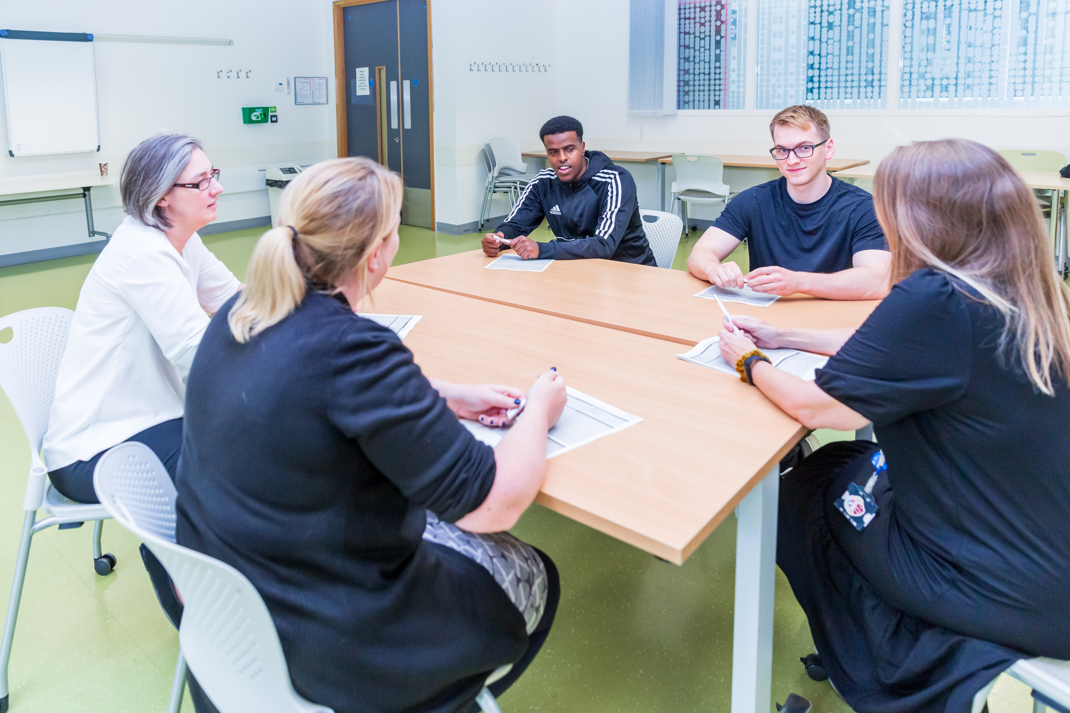
Actions we will take...
Disability
04 Implement recommendations from the NHS inclusive recruitment and promotion practices programme, ensure each stage of the recruitment pathway is accessible, does not discriminate and encourages disabled people to apply for roles. Track this via the WDES, using Trac data.
01 Demonstrate a year-on-year improvement in disability declaration rates so that ESR data is accurate about disabled people, as measured by the WDES.
02 Promote the visibility of disabled leaders through effective campaigns alongside providing leadership and career development opportunities tailored to disabled staff. Progress to be measured by tracking the number of disabled staff in leadership roles.
05 Ensure our talent management and career development programmes, are fully accessible and inclusive. Progress to be measured by tracking the number of Disabled people in leadership roles.
03 Take steps to continue to address disproportionate levels of bullying and harassment experienced by disabled staff and disparity in capability or performance.
06 Ensure our reasonable adjustments policy is effectively and efficiently implemented and achieves year-on-year improvement in NHS Staff Survey metrics relating to reasonable adjustments at work.

