Slide 1
Workforce Disability Equality Standards
(WDES) 2022/2023

Slide 2
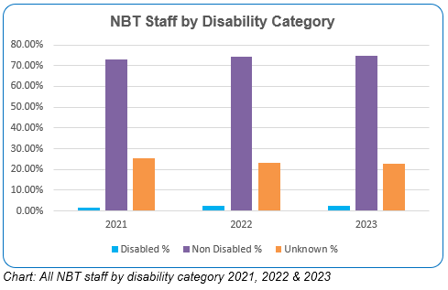
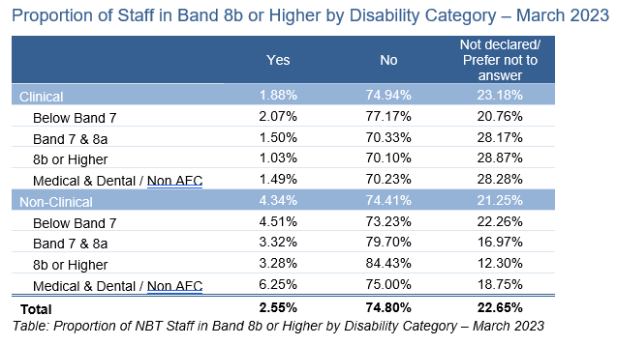
NBT Workforce composition 2022/2023
Workforce Disability Equality Standard
Staff composition at NBT of Disabled staff is 2.55% compared to 74,8% staff identifying as non-disabled, this is a 0.75% increase over 2 years
2.5 % decrease in the proportion of staff where their disability status is unknown from 25% in 2021 to 22% in 2023.
All data is for the NBT position as of 31 March 2023, unless otherwise stated. All permanent, fixed term contract and non-executive director level staff are included. Agency, bank and locum staff are not included.

Slide 3
WDES Result update 2022/2023 (1)
Workforce Disability Equality Standard
% Disabled staff in AfC bands 8a and above
Indicator 1
There was an overall increase between 2022 and 2023 in staff identifying as disabled , including bands 2,3,5,6,7,8d, consultants and non-executive directors. However, there were notable declines across Band 8 overall in last 12 months.
Total number of NBT colleagues
Disabled:
Non-Disabled:
Likelihood of appointment
Indicator 2
People who declare as disabled are 1.15 less likely to be appointed after short-listing, compared to the everyone else (those who say ‘no disability’ and ‘not stated’). However slight improvement from last year’s rate of 1.18%.
Formal capability
Indicator 3
Disabled staff are more likely to enter formal capability process at 2.45 on
average compared to non-disabled staff. Improved since previous years figure of 5.08.
Staff engagement score
Indicator 9
Disabled staff engagement is 6.4 compared to 7 for non-disabled staff and is slight decrease from the previous year but is equal to the national average
Board Representative of disabled staff
Indicator 10
1 disabled member is on the Trust Board and has voting rights out of 15 Board members in total.

Slide 4
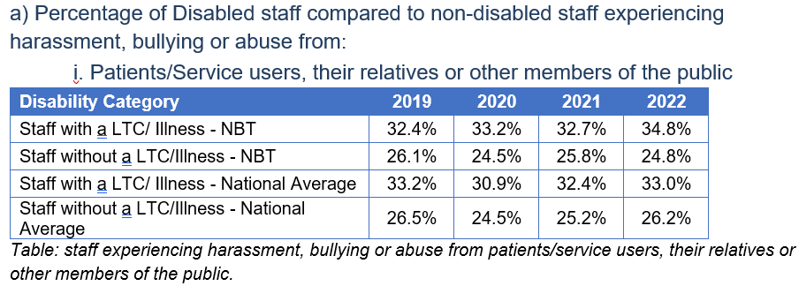
WDES Result update 2022/2023 (2)
Workforce Disability Equality Standard
% of staff experiencing harassment bullying, or abuse from patients, relatives or members of the public in the last 12 months
Indicator four ai
Total number of NBT colleagues
Disabled:
Non-Disabled:
34.8% of Disabled Staff are experiencing this compared to staff with non-disabled staff at 24.8%, this is almost 2% worse than national average
% of staff who experienced bullying, harassment or abuse at work from managers in the last 12 months
Indicator 10
13.4% of Disabled Staff are experiencing this compared to non-disabled staff at 7.8%. NBT is almost 4% better than the national average
% of staff experiencing harassment bullying, or abuse from other colleagues in the last 12 months
Indicator four aii
26.3% of Disabled Staff are experiencing this compared to non-disabled staff at 15.7%, NBT’s position is slightly better than national average
47.6% of Disabled Staff are reporting this, compared to non-disabled staff at 48.3%, NBT is slightly better 0.8% than national average
% staff who experienced bullying - they or a colleague reported it
Indicator 4b

Slide 5
WDES Result update 2022/2023 (3) Workforce Disability Equality Standard
31.4% of Disabled Staff at NBT are satisfied that their organisation values their work compared with non-disabled staff at 44.1%. This is almost 1% better than national average
Total number of NBT colleagues
Disabled:
Non-Disabled:
% of staff satisfied that their organisation values their work
Indicator five
% of staff who have felt pressure from their manager to come to work, despite not feeling well enough to perform their duties
Indicator six
26.2% of Disabled Staff felt pressure to come to work while unwell compared to non-disabled staff at 18.4%. NBT is almost 4% better than the national average
% of staff believing the Trust has equal opportunities for career development and promotion
Indicator seven
52.4% of Disabled Staff believe the Trust provides equal opportunities for career progression compared to non-disabled staff at 54.4%.
% disabled staff saying that their employer has made adequate adjustment(s) to enable them to carry out their work.
Indicator eight
72.9% of Disabled Staff say reasonable adjustments were made at NBT, which is 1% better than national average
Key
Info taken from:
ESR
Staff Survey

