Slide 1



Workforce Race Equality Standards
(WRES) 2022/2023

Slide 2
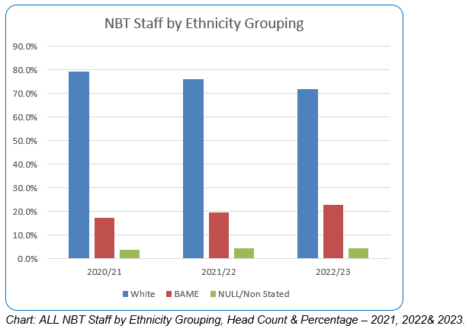
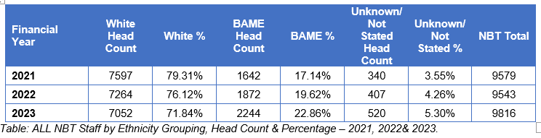

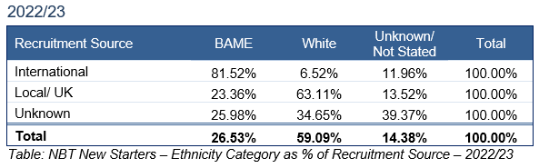



NBT Workforce composition 2022/2023
Workforce Race Equality Standard
Total number of BAME staff members at NBT
International Recruitment
Staff composition at NBT of those B.A.ME is 22.86% and White staff is 71.84%, however the unknown category has increased by almost 2%
For new recruits in year up to 31 March 2023, 81.52% of International recruits are identified as B.A.ME staff, however only 23.36% of local/UK recruited staff are B.A.ME .
The biggest proportion of newly recruited NBT B.A.ME staff come are international recruits.
This suggests our numbers of B.A.ME staff from the local population is not increasing
An increase of 3.24% or 372 headcount in the proportion of B.A.ME staff over 1 year,
All data is for the NBT position as 31 March 2023, unless otherwise stated. All permanent, fixed term contract and non-executive director level staff are included.

Slide 3
Workforce B.A.ME Data Summary
Bands | % of BAME Staff | BAME % of that Banding/ Staff Group | BAME % all staff | Total NBT BAME % | All staff Headcount | BAME Staff Headcount | Banding Headcount | BAME staff at Banding Headcount | All Staff % at Banding
Lower Band 5 & Lower | 72.30% | 29.08% | 16.53% | 22.86% | 9816 | 2244 | 5581 | 1623 | 56.85%
Medium Band 6 & 7 | 14.80% | 13.34% | 3.40% | 22.86% | 9816 | 2244 | 2504 | 334 | 25.91%
Upper Band 8a> | 1.65% | 6.97% | 0.38% | 22.86% | 9816 | 2244 | 531 | 37 | 5.41%
Medical staff | 11% | 20.83% | 2.55% | 22.86% | 9816 | 2244 | 1200 | 250 | 12.22%
Clinical | 77.67% | 24.40% | 17.75% | 22.86% | 9816 | 2244 | 7143 | 1743 | 72.77%
Non-Clinical | 22.33% | 18.74% | 5.10% | 22.86% | 9816 | 2244 | 2673 | 501 | 27.23%
Bands 8a & 8b | 1.47% | 7.99% | 0.34% | 22.86% | 9816 | 2244 | 413 | 33 | 4.21%
Bands >8c and above | 0.18% | 3.39% | 0.04% | 22.86% | 9816 | 2244 | 118 | 4 | 1.20%

Slide 4
Workforce B.A.ME by Staff Group Data
2022 |  |  |  | 2023
Staff Group | BAME | White | Unknown/ Not Stated | BAME | White | Unknown/ Not Stated
Add Prof Scientific and Technic | 12.40% | 86.00% | 1.60% | 15.09% | 83.77% | 1.13%
Additional Clinical Services | 22.51% | 75.06% | 2.43% | 28.67% | 65.30% | 6.02%
Administrative and Clerical | 9.68% | 87.92% | 2.40% | 11.67% | 86.07% | 2.26%
Allied Health Professionals | 8.33% | 88.27% | 3.40% | 9.37% | 86.27% | 4.36%
Estates and Ancillary | 33.78% | 65.13% | 1.09% | 35.94% | 62.54% | 1.52%
Healthcare Scientists | 10.74% | 86.35% | 2.91% | 13.50% | 83.54% | 2.95%
Medical and Dental | 17.35% | 65.40% | 17.26% | 20.83% | 59.58% | 19.58%
Nursing and Midwifery Registered | 26.45% | 70.42% | 3.13% | 29.82% | 67.38% | 2.80%
Students | 9.09% | 90.91% | 0.00% | 15.00% | 85.00% | 0.00%
NBT Total | 19.62% | 76.12% | 4.26% | 22.86% | 71.84% | 5.30%

Slide 5
Workforce B.A.ME by Division Data
Division | B.A.ME 2023 % | B.A.ME 2022 %
ASCR | 26.9% | 22.7%
CCS | 15.8% | 12.8%
Medicine | 28.9% | 24.9%
NSMK | 24.8% | 21.3%
WCH | 8.3% | 8.2%
Facilities | 35.9% | 33.5%
Corporate | 15.6% | 12.5%
Total | 22.9% | 19.6%

Slide 6
Medical WRES Appointment Disparity over 2 Years
 | White | Black | Asian | Other | Not known | Total
Number of applicants | 274 | 305 | 891 | 383 | 112 | 1965
Number shortlisted | 123 | 11 | 77 | 46 | 83 | 340
% Shortlisted | 45% | 4% | 8% | 12% | 74% | 17%
Number appointed | 51 | 4 | 20 | 8 | 72 | 155
% Appointed | 41% | 36% | 25% | 17% | 86% | 45%
Disparity Ratios |  | 1.3 | 1.63 | 2.5

Slide 7




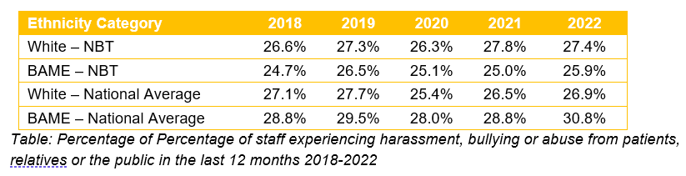
Key Findings WRES indicators 2022/ 2023
Workforce Race Equality Standard
Though there has been an increase of 3.24% or 372 headcount for staff from B.A.ME backgrounds., B.A.ME staff still remain under-represented in medium and upper bands, compared to their proportion within the Trust, 72.3% of B.A.ME staff are within lower bands (Bad 5 and below)
% number of staff in NHS trust by ethnicity
Indicator 1
The disparity ratio for B.A.ME staff being appointed from shortlisting is currently 1.71, this has worsened from our baseline set at1.46 in 2021 (though improved to 1.33 in 2022) and well below our target of 1.20
Likelihood of appointment
Indicator 2
B.A.ME staff entering into a formal disciplinary process compared to white staff in 2022/23 is 1.48%, a slight decrease from 1.49% in 2021/22.
18% of HR recorded cases involve B.A.ME colleagues compared to last year’s rate of 25%, the reduction is despite an increase of the number people recorded as going through HR disciplinary process, but not all cases are recorded
Formal disciplinary
Indicator 3
Non-mandatory training and CPD
Indicator 4
The data shows that B.A.ME staff are accessing non-mandatory training (CPD) at a slightly better rate of 23.59% compared to their proportion in the workforce (22.86) and white staff are 71.225 compared to their proportion in the workforce (71.84%). Our target is 25%
Harassment & Bullying from patients, relatives or public
Indicator 5
25.9% of NBT B.A.ME staff experience this compared to the national average of 30.8%
*Please note, the Assure HR case system is not a reliable data source for HR cases as not all the divisions consistently use it.

Slide 8

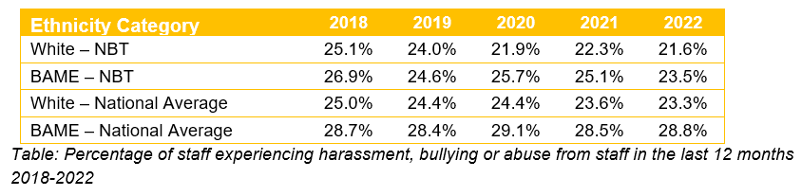
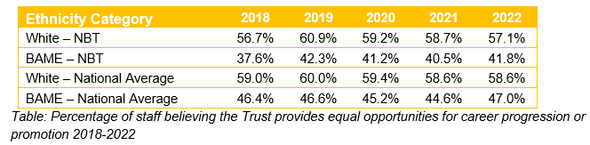

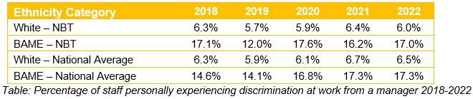

Key Findings WRES indicators 2022/ 2023
Workforce Race Equality Standard
23.5% NBT B.A.ME Staff experience this compared to the national average of 28.8% and 21.6% of white staff at NBT
Total number of BAME staff members at NBT
Harassment & Bullying from staff
Indicator 6
Staff believing equal opportunities for career progression or promotion
Indicator 7
41.8% of NBT B.A.ME staff believe this compared to the national average of 47% in 2022. and 57.1% of white staff at NBT
Discrimination at work from a manager
Indicator 8
17% of NBT B.A.ME staff experience this compared to 6% of NBT White staff in 2022.
There are 2 Board Members (Executives and Non-Executive) who identify as B.A.ME (13.33%), in 2022 only 1 Board member identified as B.A.ME
Board Ethnicity | Non-voting | Voting | Total
White | 3 | 10 | 13
BAME |  | 2 | 2
Grand Total | 3 | 12 | 15
Board representation
Indicator 9
Source: ESR/ Staff Survey

Slide 9

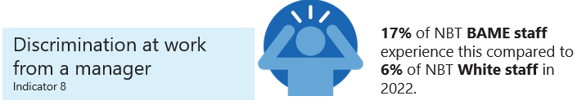
In summary….
Disparity in recruitment for B.A.ME staff has worsened significantly from 1.33 to 1.71, there are also disparity ratios in consultant recruitment. In addition over the last 2 years any increase in the proportion of B.A.ME workforce appears to be mainly from international recruitment.
There has been also been a slight improvement in disciplinary rate to 1.48 but the rate has been decreasing over the last 2 years from 1.44.
It should be noted that B.A. ME staff state they experience discrimination almost 3x more likely from managers compared to white staff within the Trust.
Though harassment and bullying from patients to B.A.ME staff has worsened just under 1%, for other staff it has improved 1.6%, in both cases our local data is better than the national average
Reviewing current priorities…
Complete System Inclusive Recruitment Review, include improvements into upcoming Fairer Recruitment Programme, in order to improve outcomes in recruitment, applications and progression.
Re-fresh the Cultural Ambassador scheme to ensure improved outcomes within disciplinary and grievance processes for B.A.ME staff and extend it to other protected characteristic groups as a Cultural and Inclusion Ambassador scheme.
Complete and evaluate first tranche of the Valuing Together Reciprocal Mentoring Programme, of at least 2 cohorts.
Review and re-launch Red Card to Racism including effective recording system and appropriate support for B.A.ME staff facing harassment, bullying or abuse.
Deliver and build on the BNSSG Race Equality Talent Management (Believe) Programme and other positive action B.A.ME staff development initiatives to increase staff progression particularly into senior levels (Bands 8a and above) across the whole Trust including medical staff in leadership roles

